Slide 1


Lecture 13: Revision
GES1009/SSA2203 Singapore’s Business History

Slide 2
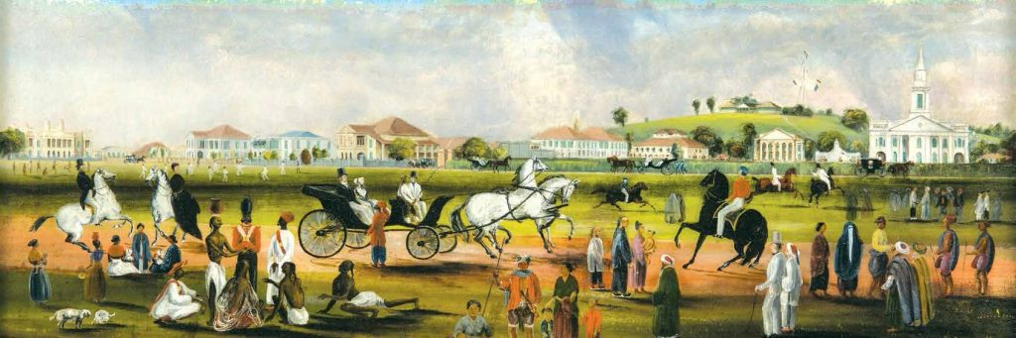
Basic Overview
Can you identity the characteristics of business in each era?
What trades and industries come to mind?
Consider ideas of continuity and change…
Can you recall the main eras in Singapore’s history?
Temasek (pre-modern history)
EIC trading base to a British colony (1819 – a modern history?)
Japanese Occupation
Merger, separation and Independence
Rapid development: from a two-legged to a three-legged policy
1997 Financial crisis- present

Slide 3
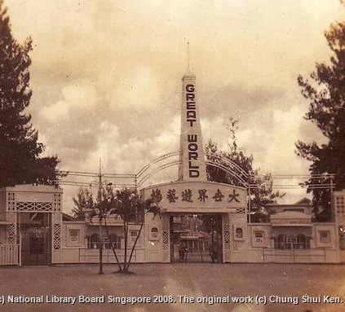

Themes:
Industries, entrepreneurs,firms heritage/icons (DB)
Communities, family business, and the developmental model of Singapore (MK)

Slide 4
Mercantile Communities
Mercantile Communities: Role in the Making of the World Economy
Trading Communities in Colonial Singapore
Arab Traders
Arrival
Economic Activities and Niches
Golden Age of Hadramis
Changing Fortunes
Chettiar Merchants
Arrival
Money-lending and other Economic Niches
The Great Depression of the 1930s and Declining fortunes of the Chettiars

Slide 5
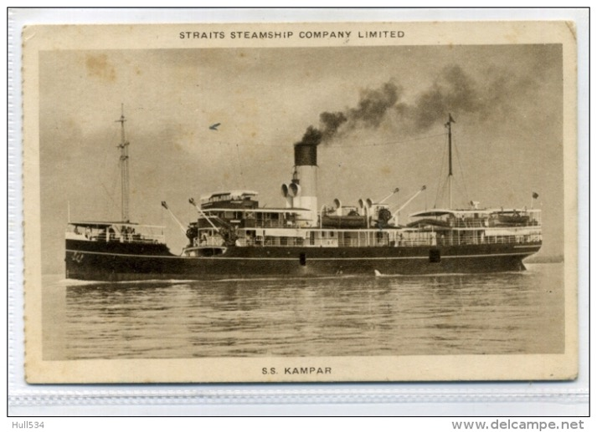
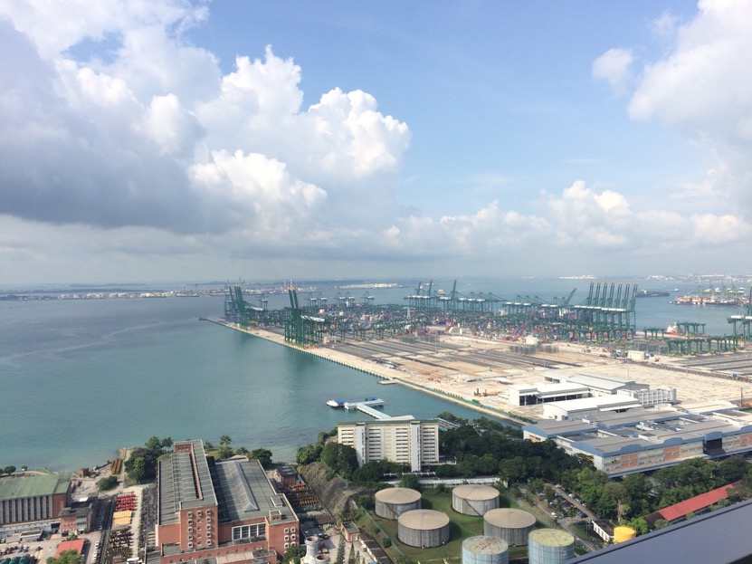
INDUSTRIES: Shipping & Banking
Shipping and banking are two industries with a long history in Singapore and have evolved as Singapore has developed…
Both local and foreign (international) influences.
Shipping: Often cited as displaying ‘modern’ business practices. (Coastal and Oceanic shipping companies)
An example of ‘transformative’ technologies and the role they play in transforming economies and also business practices.

Slide 6
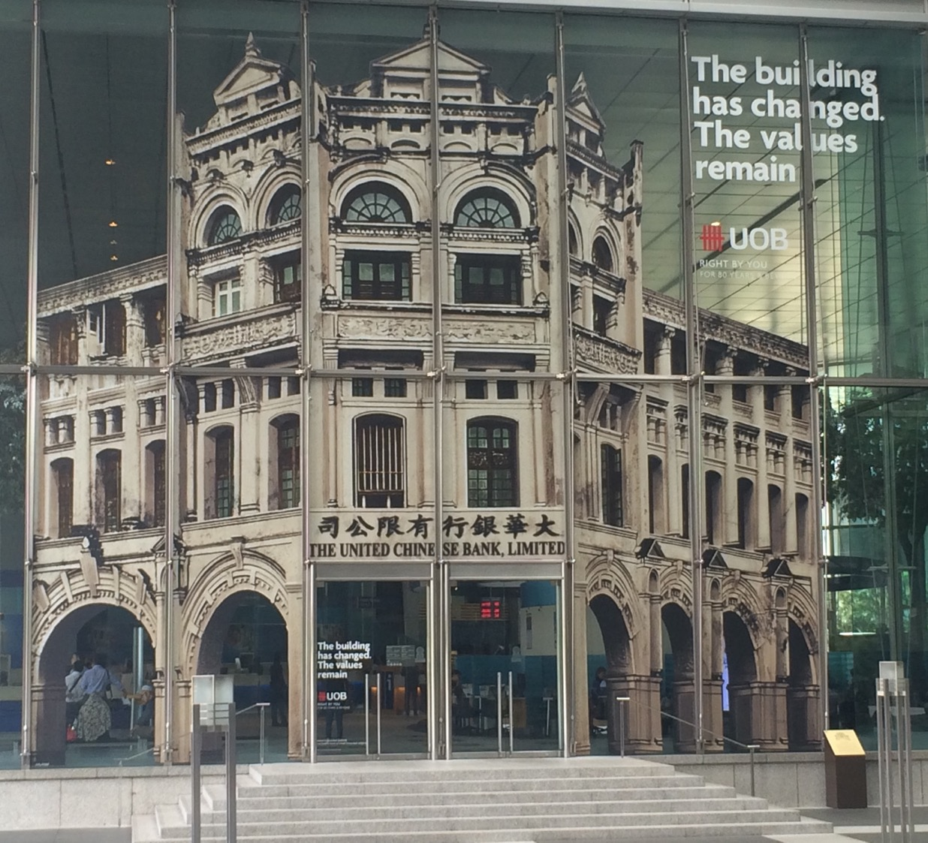
Banking in Singapore
Traditional Sources of Finance
Coming of the European Banks
Rise of Chinese Banking
Dialect Based Banking
Problems in Chinese Banking
Role in Economic & Financial Development
Characteristics of Pre WWII Banking
Financial Dualism, 1950s-1960s
Emergence of Singapore as an International Financial Centre 1970s & beyond

Slide 7

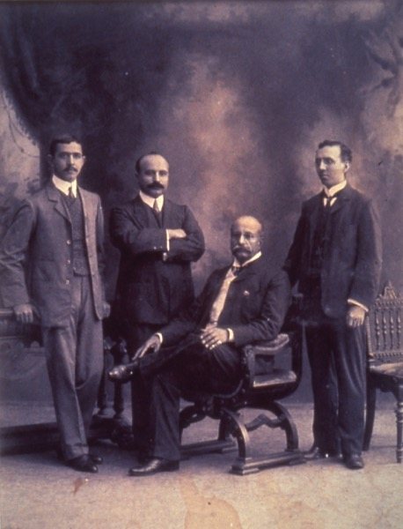
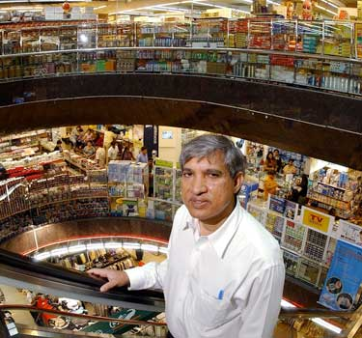
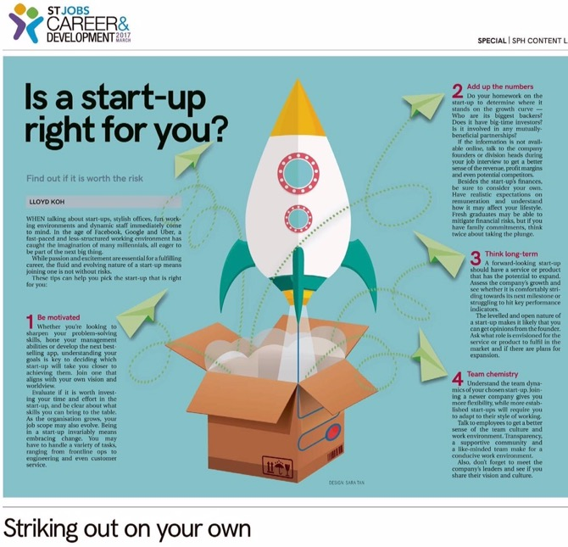
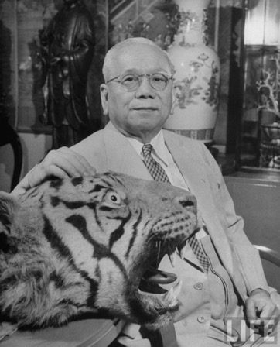

Entrepreneurs
How do you define an entrepreneur?
How has the idea of entrepreneurship changed over time?
What values are important to entrepreneurs?

Slide 8

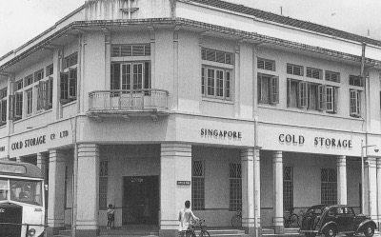

Firms:
COLD STORAGE

Slide 9
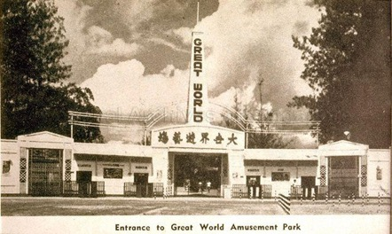
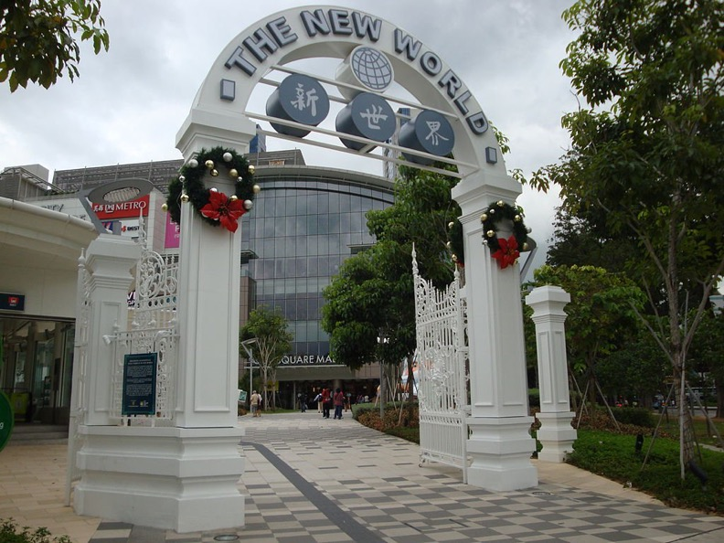
SHAW BROS
Considering the Shaw Brothers and Shaw film industry as a firm and an example of leisure.
Significant to the film industry AND also theme parks/ amusement parks.
Business strategies for developing films with a Southeast Asian appeal.

Slide 10
FAMILY CAPITALISM
Characteristics of ‘Family’ Business in Asia
Defining Family Business
Theoretical literature on Family & Firm
Wong Siu-lun, Gordon Redding, Henry Yeung etc
Case study:
Eu Yan Sang, Singapore
Challenges to contemporary family firms

Slide 11
Models of Growth (I)
Wong Siu-lun’s 4-stage model
Emphasis on family members
Stage 1
Emergent
Partners
Stage 2
Centralised
Patriarch
Stage 3
Segmented
Brothers
Stage 4
Disintegrative
Cousins

Slide 12
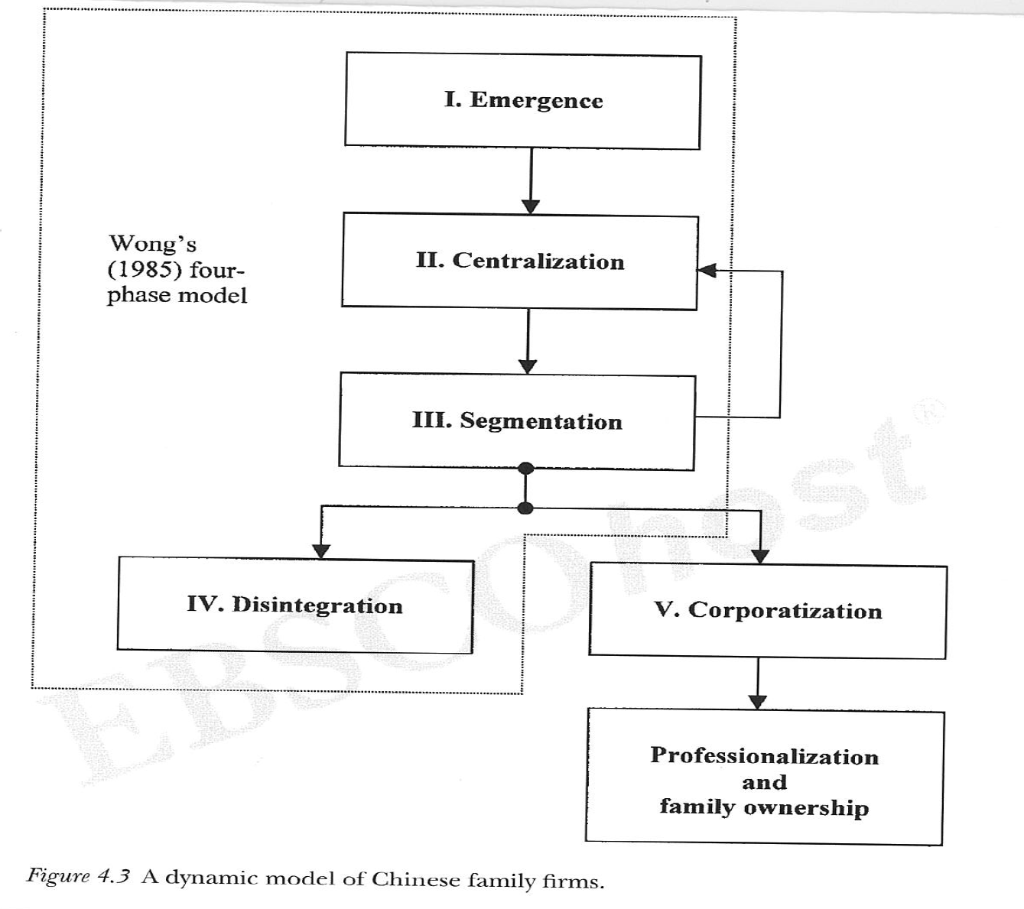
Models of Growth (II)
Henry Yeung W. C, Chinese capitalism in a global era : towards hybrid capitalism chapter 4, pp. 154.

Slide 13
Singapore Model of Development
Singapore Inc. late 1950s onwards: Economic Trajectories
Successes of the Developmental State
Challenges and Strategies, 1990s & Beyond
Globalized environment, ICT, Knowledge based economy: Respoding to these challenges & Refining the Developmental Model
Setting the Stage for the Future

Slide 14
Singapore Model of Development
Singapore, late 1950s: Politics & Economic Trajectories
Post-Independence Economic Priorities & Policies
Polices towards the Private Sector: Marginalization & Uncertainty
Turning Point, mid 1980s: ’Privatization’ & local business
Transitions, 1960s- 1990s & Beyond
The Success of the Singapore's Economy & the Singapore Model of Development

Slide 15
What lies behind this success? What is the Singapore Model of Development
The Debate: Free Market Vs Economic Planning
Heavily interventionist state
Owns, controls/ regulates land, labour and capital resources & their allocation
Government Controls & Directives
‘Plan and Market in creative partnership’

Slide 16
Singapore’s Developmental State, late 1950s onwards: Economic Trajectories
Singapore Inc: based on FDI and MNCs
Efficient management of economic resources; politically well managed
Worked in delivering jobs, housing, incomes, education, economic and social security
Governed market & Industrial policy have changed
More recognition of the private sector, esp MNCs
1995: Regrouping in support of PLE
Opening up to more competition in banking: Telecommunication & utility sectors
Diversifying business and market connections; enhancing competitiveness, creative managerial leadership

Slide 17

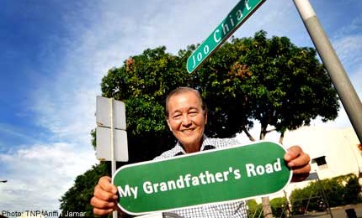
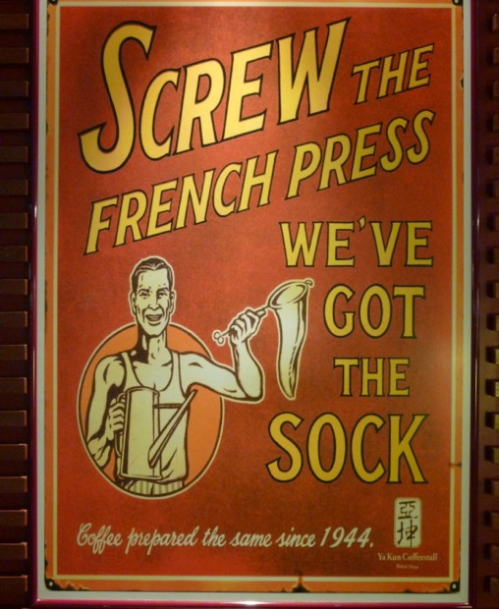
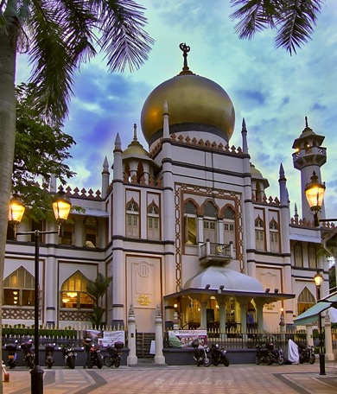
Heritage and Icons
Heritage branding as a way of promoting a business…
Conservation of areas linked to early migrant & business enclaves
Questions about nostalgia and the authenticity of ‘traditional’ businesses and trades…(the kopitiam as an example?)

